Slide 1
MeF Schema Changes
August 13, 2014
FTA Tech
IRS Name Standardization

Slide 2
Recap of Schema Changes
2013 IRS Released Round 1 of Name Standardization
TIGERS used this release for inital1041 development
May 2014 – TIGERS votes to incorporate Name Standardization changes to Individual and Business schemas
  TIGERS asked to create a draft set (individual/business) of schemas based on last year’s release
After symposium TIGERS found a recent Name Standardization release and used that for the draft
End of July IRS released another version of the Name Standardization
TIGERS released a new set of draft schemas for Individual, Business, EstateTrust based off of efile1040_2014v2_0_07282014

Slide 3
High level summary of changes
Common words abbreviated (Description, Amount, Name)
In some instances the addition of a data type suffix is added (AddressLine1 vs. AddressLine1Txt)
Names changed to match common usages of the same information (AddressInUS vs. USAddress)
Element names changed to be more descriptive (Amount vs. ForeignAmt)

Slide 4
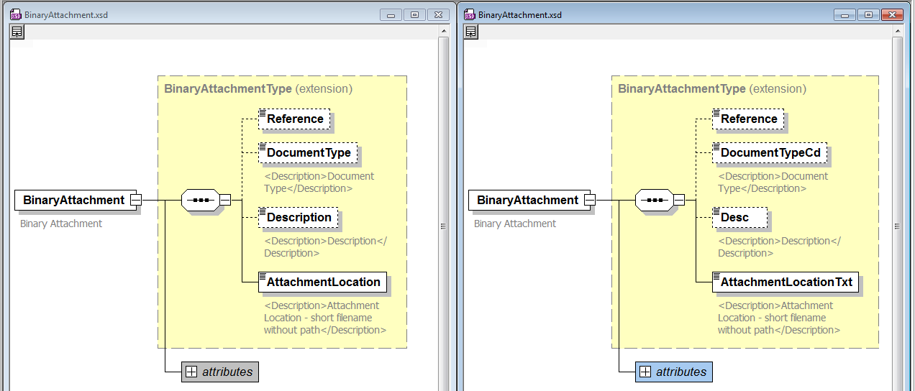
Common/BinaryAttachment.xsd

Slide 5
Common/efileTypes
Old Name | New Name |  | Old Name | New Name
documentCount | documentCnt |  | AddressLine1 | AddressLine1Txt
softwareVersion | softwareVersionNum |  | AddressLine2 | AddressLine2Txt
Description | Desc |  | City | CityNm
PostalCode | ForeignPostalCd |  | State | StateAbbreviationCd
PersonName | PersonNm |  | ZIPCode | ZIPCd
BusinessName | BusinessName |  | ProvinceOrState | ProvinceOrStateNm
IPv6Address | IPv6AddressTxt |  | Country | CountryCd
VehicleYear | VehicleModelYr |  | AddressInUS | USAddress
AddressInForeign | ForeignAddress |  | PersonLastName | PersonLastNm
PersonFirstName | PersonFirstNm |  | IPv4Address | IPv4AddressTxt

Slide 6
Common/efileTypes cont.
Old Name | New Name
Amount | Amt (USItemizedEntryType)
Amount | ForeignAmt (ForeignItemizedEntryType)
DepreciationConventionType | DepreciationConventionCodeType
DepreciationMethodType | DepreciationMethodCodeType
BusinessNameLine1 | BusinessNameLine1Txt
BusinessNameLine2 | BusinessNameLine2Txt
VehicleDescriptionType | VehicleDescriptionGrpType
VehicleMake | VehicleMakeNameTxt
ForeignEntityReferenceIdNumber | ForeignEntityReferenceIdNum
VehicleModel | VehicleModelNameTxt

Slide 7
Common/ReturnHeader
Jurisdiction – changed type to GovernmentCodeType
Old Name | New Name |  | Old Name | New Name
Timestamp | ReturnTs |  | SelfEmployed | SelfEmployedInd
TaxPeriodBeginDate | TaxPeriodBeginDt |  | SSN | PreparerSSN
TaxPeriodEndDate | TaxPeriodEndDt |  | Phone | PhoneNum
TaxYear | TaxYr |  | ForeignPhone | ForeignPhoneNum
DisasterRelief | DisasterReliefTxt |  | EmailAddress | EmailAddressTxt
ISPNumber | ISPNum |  | Originator | OriginatorGrp
DateSigned | SignatureDt

Slide 8
Common/ReturnHeader cont.
Old Name | New Name
PaidPreparerInformation | PaidPreparerInformationGrp
PreparerFirmIDNumber | PreparerFirmEIN
PreparerBusinessName | PreparerFirmName
PreparerPersonName | PreparerPersonNm
PractitionerPIN | PractitionerPINGrp
SoftwareVersion | SoftwareVersionNum
PrimaryPINEnteredBy | PrimaryPINEnteredByCd
SecondaryPINEnteredBy | SpousePINEnteredByCd
binaryAttachmentCount | binaryAttachmentCnt

Slide 9
StateIndividual/
IndividualReturnHeaderState
Old Name | New Name
InCareOfName | InCareOfNm

Slide 10
StateBusiness/
BusinessReturnHeaderState
Old Name | New Name
Name | BusinessName
InCareOfName | InCareOfNm
NameControl | BusinessNameControlTxt
Name | PersonName
Title | PersonTitleTxt
Phone | PhoneNum
ForeignPhone | ForeignPhoneNum
EmailAddress | EmailAddressTxt
DateSigned | SignatureDt
MultipleSoftwarePackagesUsed | MultSoftwarePackagesUsedInd

Slide 11
StateBusiness/
BusinessReturnOtherHeaderState
Old Name | New Name
SoftwareVersion | SoftwareVersionNum
TaxPeriodBeginDate | TaxPeriodBeginDt
TaxPeriodEndDate | TaxPeriodEndDt

Slide 12
Common/ EstateTrustReturnHeader
Jurisdiction – change the type to GovernmentCodeType

Slide 13
Changes for consideration
ReturnHeader and ReturnHeaderState schemas are a morph between TIGERS constructs and the IRS schema. Updates to these schemas were made if the element names and type matched in the previous year but were changed for Name Standardization even if the construct was different.

Slide 14
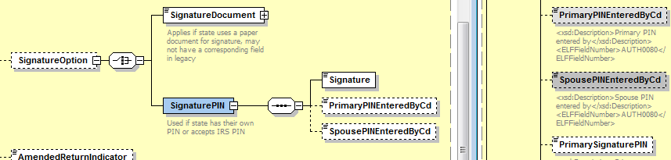
Change #1 – ReturnHeader
SignaturePIN
Primary and Spouse elements changed since the names matched even though the nesting does not match the IRS.

Slide 15
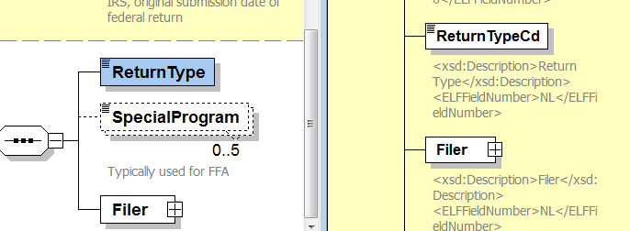
Change #2 – IndividualReturnHeaderState
ReturnType
ReturnType not changed since the IRS version of the element is an inline enumeration vs. the TIGERS ReturnTypeType definition.
Notes:
Exists in all three schemas.

Slide 16
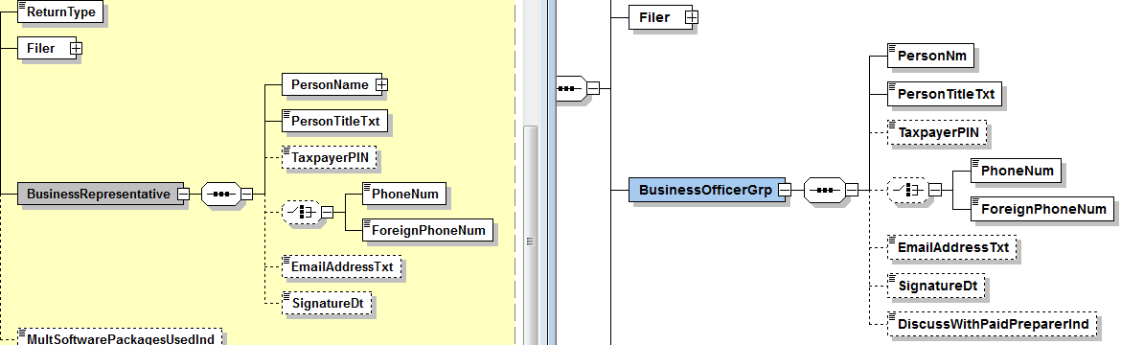
Change #3 – BusinessReturnHeaderState
BusinessRepresentative
Are BusinessRepresentative and BusinessOfficerGrp essentially the same elements. Should we rename the TIGERS element and should DiscussWithPaidPreparerInd be added?
  If DWPPI is added, what about 1040 & 1041.
Notes:
What about the other tax types (1041, 1040)?

Slide 17
IRSForms
IRS1099R, IRSW2, IRSW2G have been updated with the latest version from the IRS.
State1099(Div, G, Int, Misc, Oid) have remained the same. Should these have the element names standardized?

Slide 18
Current Draft Numbering
Current draft versions are as follows:
  StateIndividualPackageV6.2_draft
  StateBusinessPackageV5.2_draft
  StateEstateTrustPackageV3.1_draft
These versions are available at: http://www.statemef.com/mef_new.shtml
Once finalized and ratified the draft versions will be pulled and replaced with the finalized versions which will be numbered as 6.0, 5.0 and 3.0 respectively.

Slide 19
Questions?

