Slide 1
Child Support Invades Cyberspace

Slide 2
Panelists/Speakers
Corri Flores
Employed with ADP since 1995
Manages a team that are the liaisons to agencies for New Hire Reporting, Unemployment Insurance, Tax e-File projects and wage garnishments
Member of two GATF garnishment subcommittees with APA
BS, University of Phoenix

Slide 3
Panelists/Speakers
Cindy McMullen
Payroll Manager, Dollar Tree Stores for Over 5 Years
    Over 5,000 retail locations in all US states except Alaska and Hawaii
    Locations in Canada
    Over 89,000 associates
Over 23 Years of Payroll Experience, 18 in Management
CPP Since 1999
Member of the APA
SPLTF – Retail Best Practices sub-committee
Member of Toastmasters International

Slide 4
Panelists/Speakers
Robyn Large
  OCSE Employer Services Team
  Child Support professional since 1986
  Eastern Regional Child Support Enforcement Association Board Member

Slide 5
Panelists/Speakers
Bill Stuart
With Child Support since 1970
  County Child Support Coordinator for 12 years
  Director of NYS Child Support system for 17 years
  Worked on electronic Income Withholding Order project since 2004
  MA from State University of New York at Albany

Slide 6
Agenda
Explain e-IWO Project
Employers’ experience with e-IWO
  Implementation strategy
  Their Experience
  Suggestions, Lessons Learned
EFT Overview and Statistics
EFT from Employers’ Perspective
  Reasons to Implement
  Helpful Hints
  Challenges

Slide 7
What is e-IWO?
States electronically send IWOs
Employers electronically accept/reject IWO
Federal Employer Identification Number (FEIN) is key
Handles terminations, lump sum payments
Implementation Options
  System to system
  Fillable PDF and Spreadsheet
No Cost to Employers

Slide 8
Portal Registration
Everyone must register
Complete a Profile form
Registration includes Agreement

Slide 9
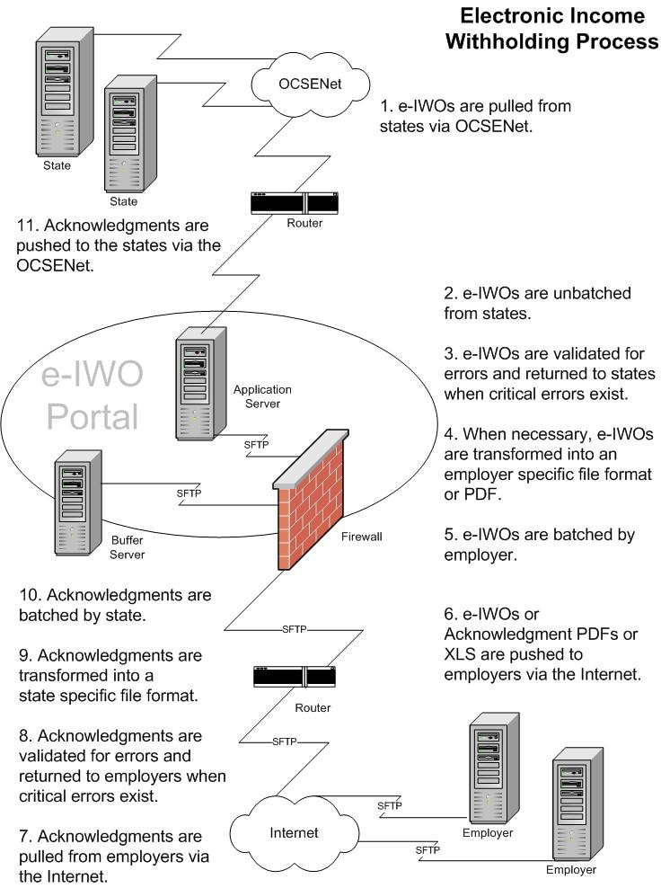

Slide 10
System to System Implementation
For larger employers
Flat File or XML Schema offered
Mapping
IWOs received in file/batches
Image Ready PDF Order Offered
Employer generates Acknowledgement
Manual processing minimized
3 – 5 Month IT Resources

Slide 11
eZ-IWO “No Programming” Options
Option 1
  PDF Income Withholding Order and
  PDF Acknowledgement
    Pretty Darn Fast
Option 2
  PDF Income Withholding Order and
  XLS Acknowledgement
    Xtreme Lightning Speed

Slide 12
The PDF Acknowledgement Option
In production since fall 2009
120+ Employers using PDF Acknowledgement
Sample – next slide
Reduces the IT resources required
Accept or reject the IWO
Acknowledgement information provided to states
Handles termination and lump sums

Slide 13
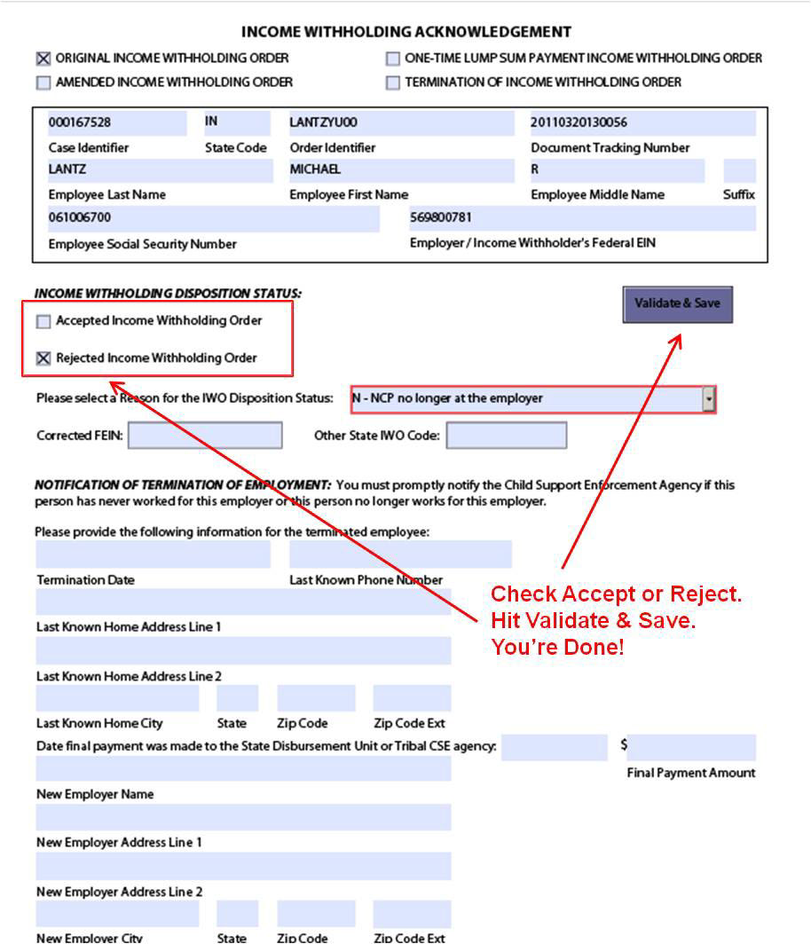

Slide 14
The XLS Acknowledgement Option
In Production since fall 2009
60+ Employers using XLS
Sample – next slide
Reduces the IT resources required
Accept or reject IWO
Acknowledgement information provided to states
Handles termination and lump sums

Slide 15
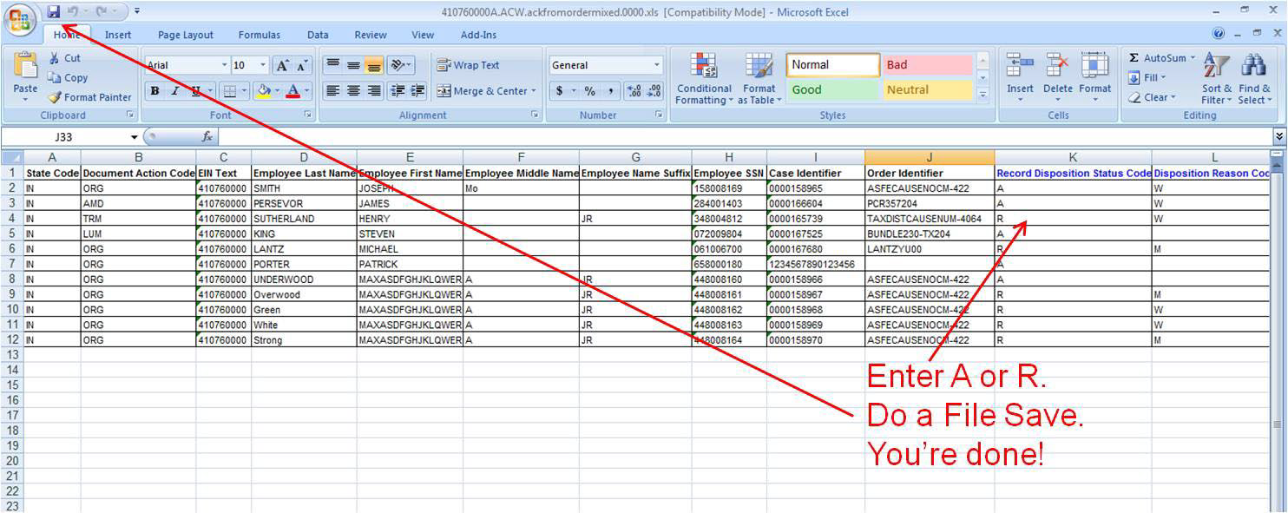
XLS Acknowledgement Sample

Slide 16
Mix and Match!!
Acknowledgements accepted in any format
PDF and Spreadsheet example
Acknowledgements to almost all States, June 2014

Slide 17
Daily Process e-Mail Notifications
PROCESSING SUMMARY
Total # of records received: 28
Total # of error records: 1
Total # of records forwarded: 27
Total # of files rejected: 0
Total # of batches received: 11
FILES SENT TO YOUR ORGANIZATION
IWO Details: 18
Acknowledgements: 0
PDF Orders: 18
PDF Acknowledgements: 0
XLS Acknowledgements: 0
Error: 1
Reject: 0

Slide 18

Ready, Set, Go!
What do I need?
  Secure File Transfer Protocol (SFTP) Server or
  FTP Server with a Virtual Private Network or
  File Transfer Protocol Secure (FTPS)
  We will help you establish connectivity

Slide 19
Ready, Set, Go!
I want to do this !!!
  NO Cost to employer
  Fill out Profile
  Set up connectivity
  Conduct a test
  Start receiving Acknowledgements

Slide 20
States Using e-IWO
Alabama
Arizona
Arkansas
California
Colorado
Connecticut
Delaware
District of Columbia
Florida
Hawaii
Idaho
Illinois
Indiana
Massachusetts
Michigan
Missouri
Nebraska
New Jersey
New York
North Carolina
North Dakota
Ohio
Oklahoma
Oregon
Pennsylvania
South Dakota
Tennessee
Texas
Virginia
Washington
West Virginia

Slide 21
Some of the 550+Employers on e-IWO – Comprising 6,000+ FEINs
Adecco
ADP
Coca-Cola Refreshments
Costco
Disney
DOD
Dollar General
Dollar Tree
Express Professionals
G6 Hospitality
Jack in the Box
KBR
Kelly Services
Meijer
Pepsi
Peoplelink
Quest Diagnostics
Ruby Tuesday
Staffmark
Target
Tyson Foods
UPS
Time Warner Cable
UPS
USPS
Verizon
Wal Mart
Yum! Brands

Slide 22
The Benefits
Child support gets to the family sooner
Adding additional employers (for states)
or states (for employers) is straightforward
Increases collections
Saves time, money, and resources
Ensures uniform IWO data from all states
Increases accuracy and reliability of data

Slide 23
TWO Million – And Counting!!!
On September 29th, 2012
the e-IWO Portal processed
its 1,000,000th order!!
At the end of October 2013
the e-IWO Portal processed
its 2,000,000th order!!

Slide 24
Resources
Link to e-IWO on OCSE Website http://www.acf.hhs.gov/programs/css/employers/e-iwo
e-IWO Fact Sheet - Handout
e-IWO Workgroup

Slide 25


In Summary
DO THIS
e-IWO
NOT THAT

Slide 26
Got Questions?
Contact Bill Stuart – (518) 399-9241
  William.stuart@acf.hhs.gov
  BOOTH #1117

Slide 27
E-IWO and Dollar Tree
Our Implementation Election
Why Did We Implement?
Values of Implementing
Next Steps

Slide 28
Our Implementation Election
APA Congress – The Promoters of New and Improved Solutions
Implementation Time and Manpower Considerations
PDF Income Withholding Orders and Acknowledgements
Testing
State Validation
GO!!!!

Slide 29
Why Did We Implement?
Cost Effective
Improved Efficiencies
Reduced Volume of Paper and Duplicates
Speed and Ease of Transactions
Security

Slide 30
Values of Implementing
Cost Effective
Improved Efficiencies
Security
Improved Relationships
Think of the Benefit to the Children

Slide 31
Next Steps
Growing Number of States Electing Participation
Data Interface Files

Slide 32
ADP
Leading global solutions provider for over 50 years
  585,000 total ADP clients located in 31 countries, with 46,000 associates worldwide
Pays 1-in-6 private sector workers in the U.S.
Electronically move over one trillion in client - related funds
Handles all types of Wage Withholding Orders

Slide 33
eIWO and ADP
How ADP Got Involved
Processing in the New World
Steps Along the Way
Lessons Learned
Our Journey Continues

Slide 34
How ADP Got Involved
Garnishment processing since 1997
Active participants since the creation of the eIWO workgroup
  Attended first meeting in Chicago
Considered a project within ADP
Authorization process needed to be defined internally
Determine formats to receive
  PDF file or not?

Slide 35
Processing in the New World
Clients authorize ADP to receive e-IWO’s
Client’s federal employer identification number (FEIN) information transmitted to OCSE
  FEINs filtered on to the states
30 days to add/terminate clients from the process
ADP receives XML files via the portal from participating states

Slide 36
Steps Along the Way
Dedicated internal project group met weekly
Completed functionality testing
Developed internal training classes
  New procedures
Determined clients for internal pilot participation
  Phased implementation for existing clients

Slide 37
Lessons Learned
Benefits
  Increased security of confidential data (Social Security numbers)
  Faster turnaround and increased accuracy
  Standardization and consistency of data received
  Reduction in calls for status of case/order
  Payments disbursed faster
Detours and Roadblocks
  Internal resources - multiple internal system development needed
  Not all states participating - continue to maintain 2 processes
  Some paper orders continue to be sent due to local offices
  Enhancements needed periodically

Slide 38
The Journey Continues
Electronic transmission of FEINs
Reconciliation of orders that need to be converted to electronic
Lump sum capability

Slide 39
PRWORA mandates SDUs with EFT
State disbursement units (SDUs) are established
Two days to process payments
All SDUs are now receiving/sending
e-payments except South Carolina

Slide 40
Employers benefit from e-payments
Safer:
  prevents theft and fraud
Cheaper:
  eliminates postage costs
Faster:
  eliminates lost mail and mail delays
More accurate:
  savings in time and labor

Slide 41
Employers benefit from e-payments
Standardization:
  single file format valid for all SDUs
Supported by most software
Complies with growing trend in state legislation mandating EFT (16 states)

Slide 42
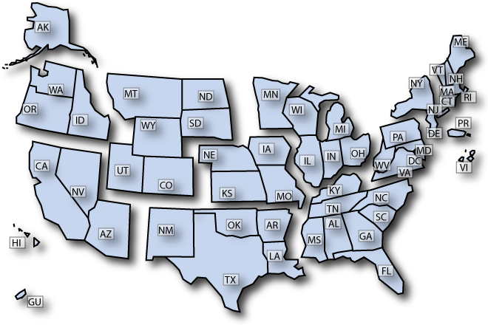
16 states require e-payments

Slide 43
16 states require e-payments
CA, FL, GU, IA, IL, IN, MA, ND, NE, NV, OH, OR, PA, TX, VA, and WV
EFT isn’t going away
Software developers realized they need to support EFT for child support

Slide 44
EFT choices for employers
Employers can:
Use their own payroll/accounting system (ACH credit payments)
Outsource to payroll service providers
Use state online payment services (recommended for small employers)
Use a commercial vendor

Slide 45
Getting Set Up
Contact your bank to discuss sending ACH credit payments
Contact the SDU:
  http://www.acf.hhs.gov/programs/css/employers/electronic-payments
Perform case reconciliation
Send a test file
Send live payment

Slide 46
Join Our e-Payments Community
  EFT payments from employers, interstate and, direct payers to SDUs continue to increase:
    2010: 53%
    2011: 56%
    2012: 58%
    2013: 60%

Slide 47
Employer Challenge:
Payments not Directed to SDUs
Most child support payments should be paid to the SDU, but some orders may still order the payment to the custodial party, attorney or other entity
See
  http://www.acf.hhs.gov/programs/css/resource/revised-income-withholding-for-support-iwo-form
  for guidance regarding orders that do not direct payments to the SDU

Slide 48
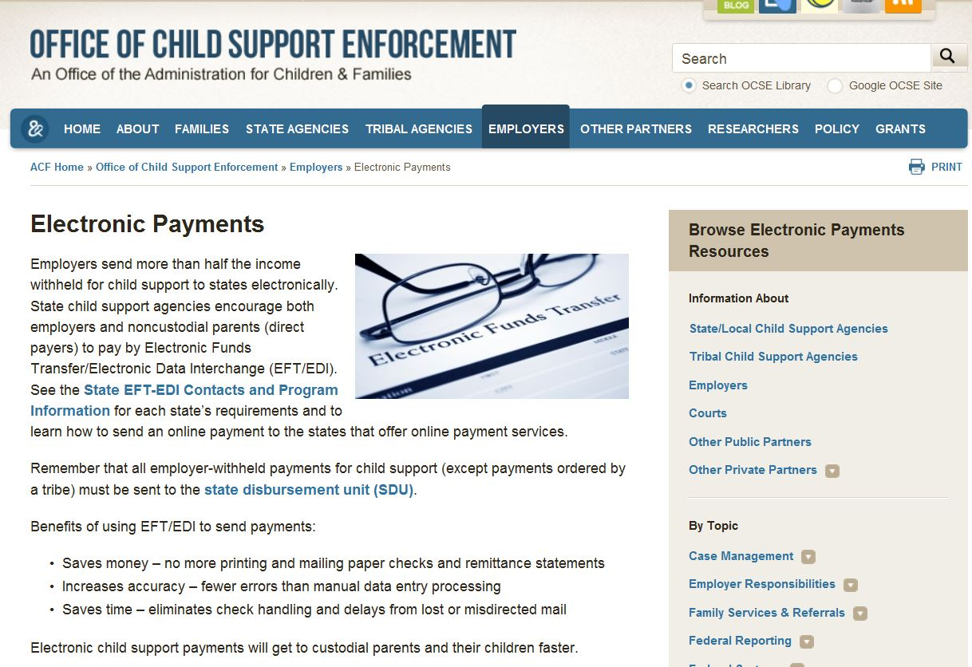
OCSE Employers Website
http://www.acf.hhs.gov/programs/css/employers/electronic-payments

Slide 49
Questions?
Please contact me:
Robyn Large
  Robyn.large@acf.hhs.gov
  Phone: 240-676-1437

Slide 50
EFT - Employer’s Perspective
Dollar Tree’s Implementation
Reasons to Implement
Why Other Employers Should Implement

Slide 51
EFT – The Service Provider Story
Why EFT?
Implementing EFT
ADP Information
Next Steps

Slide 52
Why EFT?
Seamless to ADP employers
Saves employers from having to complete programming/development
Correct payment information is key
NACHA standard format has made the process efficient – states cannot deviate

Slide 53
Implementing EFT
Regardless of new employers joining ADP’s service, no new testing needed
ADP updates all information regarding EFT changes (i.e. bank account changes, etc)
Case ID/payment related information is critical and in some cases, only the employer can update the ID

Slide 54
ADP Statistics
ADP sends EFT child support payments to all states and counties (SC) that offer EFT
    60% of all child support payments sent via EFT
Reduces the need to void or stop checks
Eliminates lost checks
Reduction in the administrative/mailing costs

Slide 55
Next Steps
Potential to leverage with other lien types
Implementing EFT with additional non child support agencies
  Wisconsin tax levy (mandated)
  Student Loan Agencies
  Trustee’s
  Large Creditor Agencies
ADP is implementing the NACHA TPP file format for State Tax Levy Agencies

Slide 56
Questions???
Thank you!
Contact information:
  Corrinne.flores@adp.com
  909-971-5858

Slide 57
Wrap Up
Any questions about e-IWO or EFT?

